Slide 1
Pengolahan Citra Digital Digital Image Processing RTI147006
Filter Spatial

Slide 2
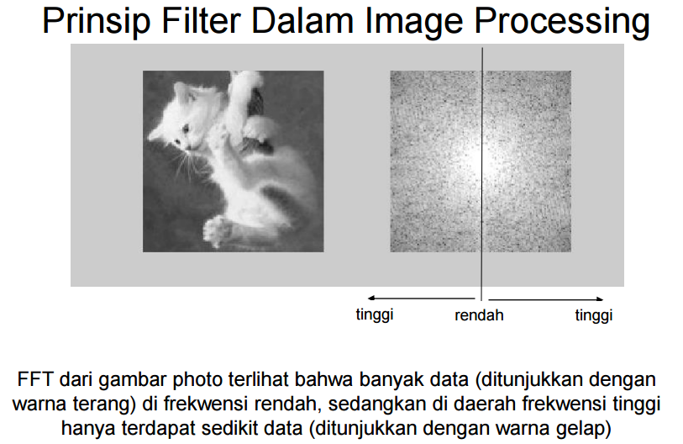

Slide 3
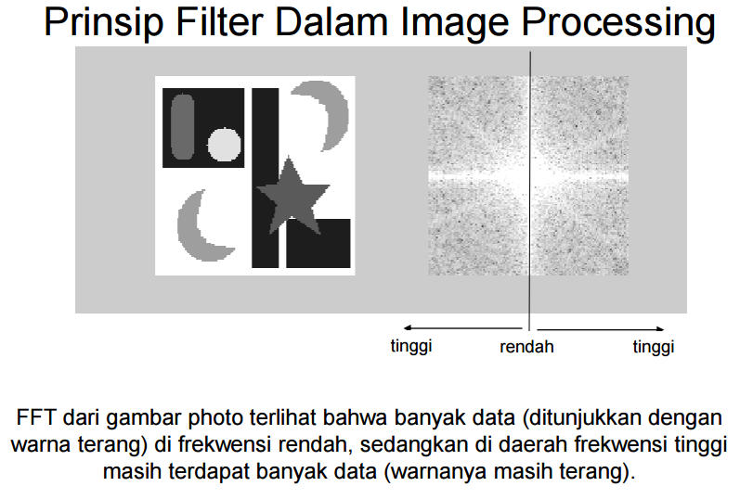

Slide 4
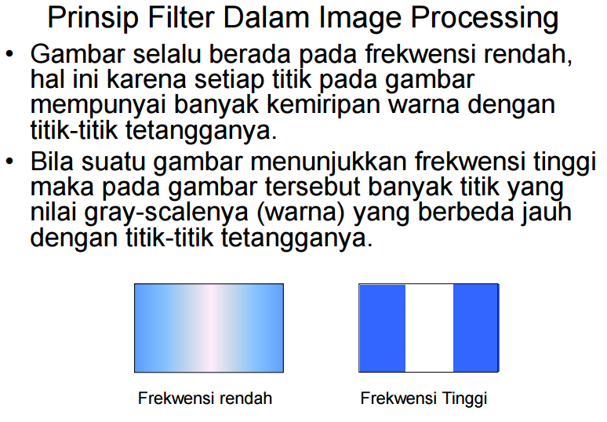

Slide 5
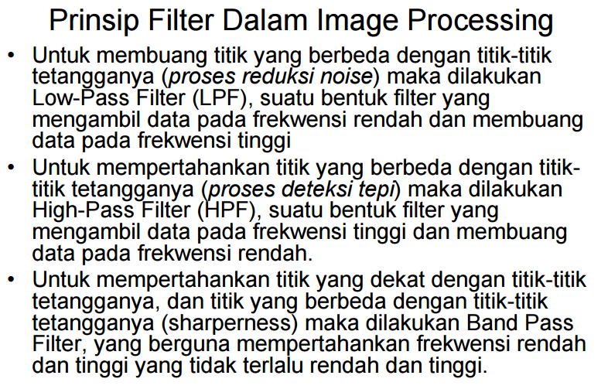

Slide 6
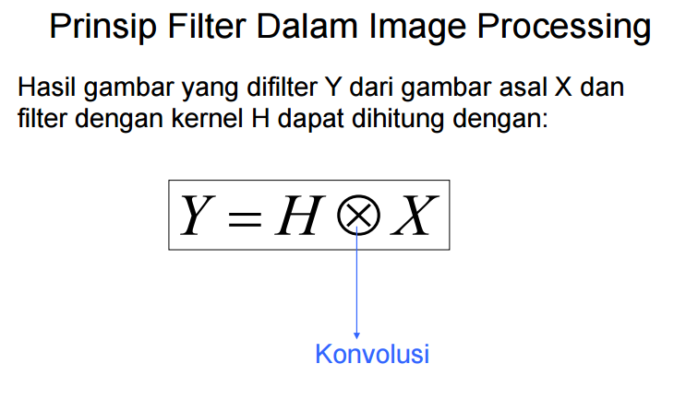

Slide 7
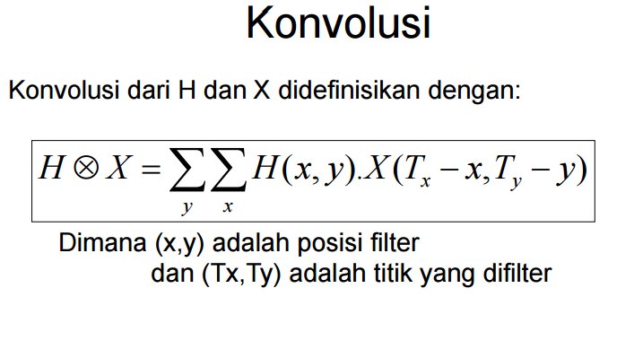
H = Kernel
X = Gambar
T = posisi gambar

Slide 8
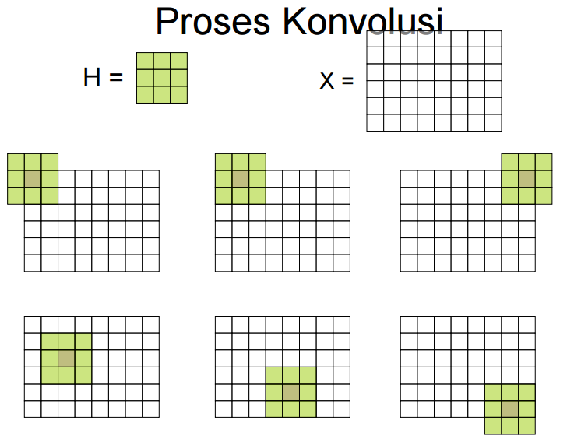

Slide 9
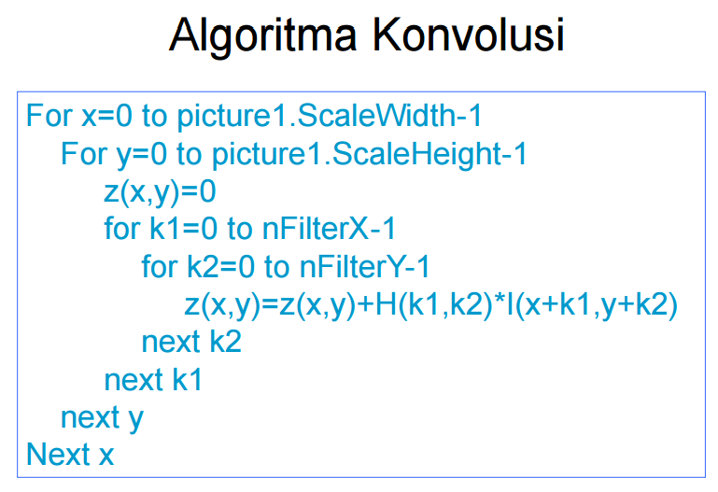

Slide 10
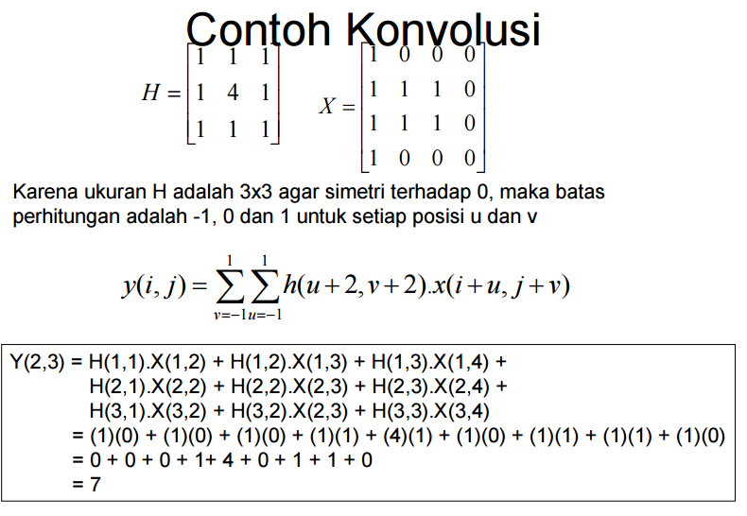

Slide 11
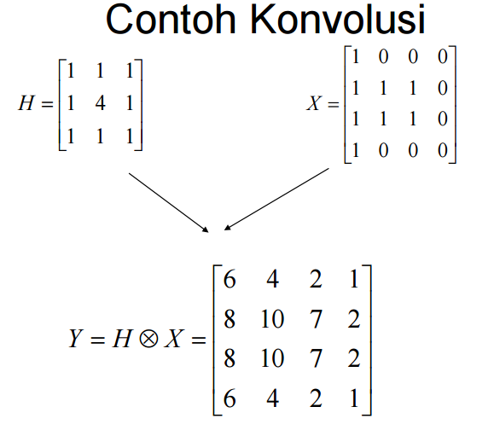

Slide 12
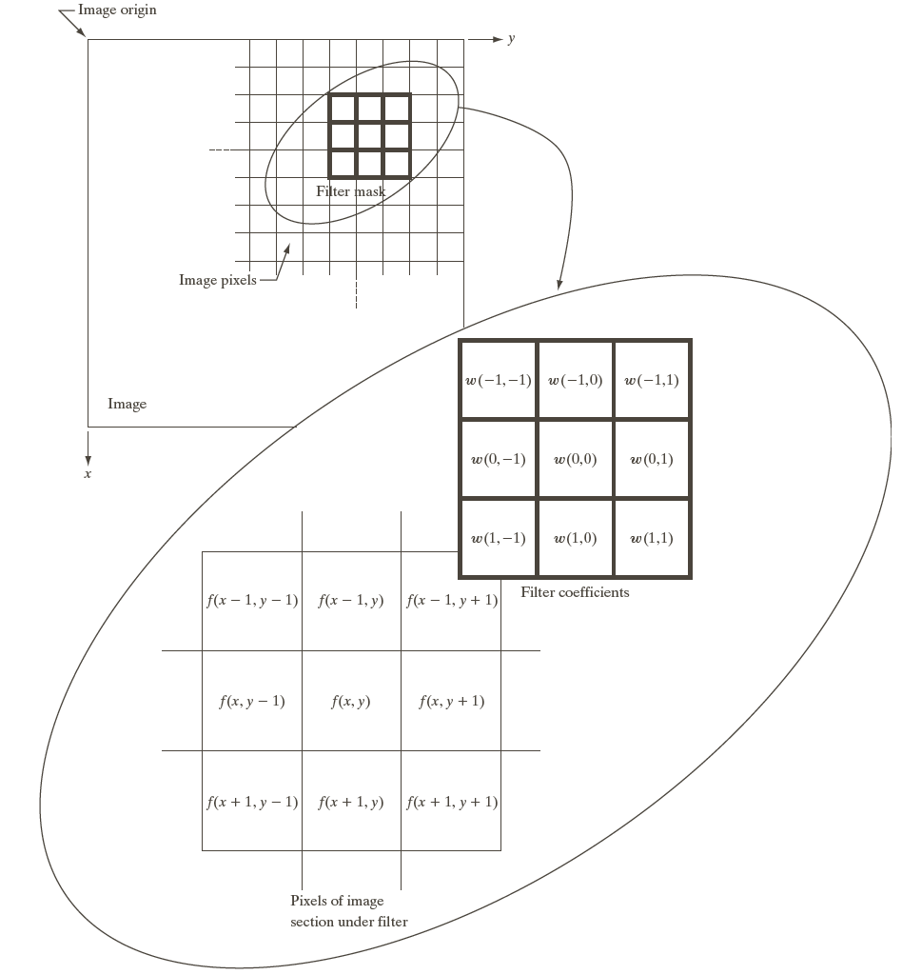

Slide 14
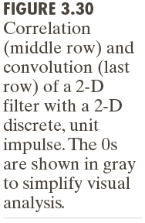

Slide 15
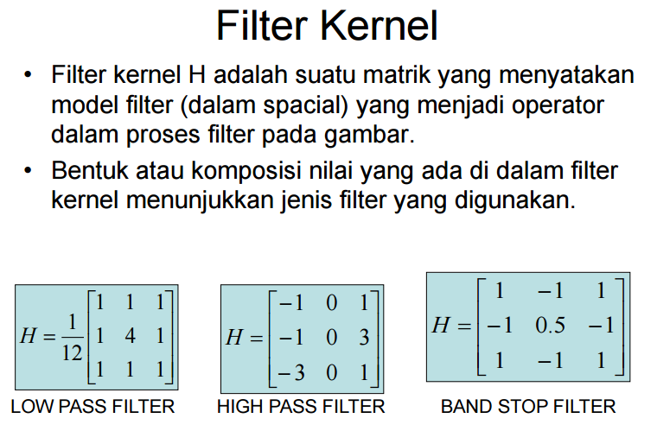

Slide 16
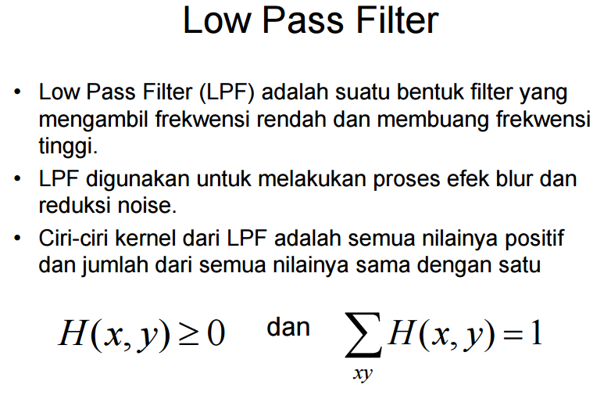

Slide 17
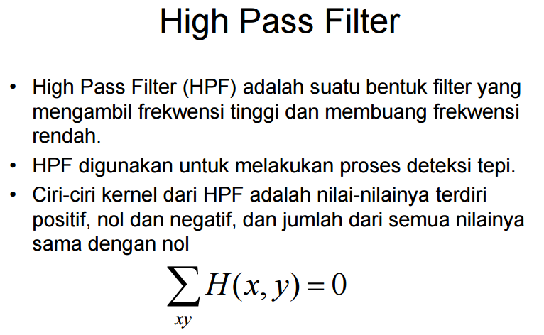

Slide 18
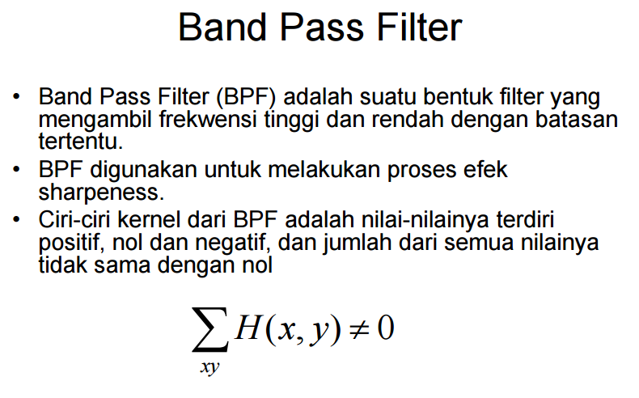

Slide 19
Point Detection
$g\left(x,y\right)= \left\{\begin{aligned}1 if |R\left(x,y\right)≥T \\ 0 otherwise \end{aligned}\right.$

Slide 20
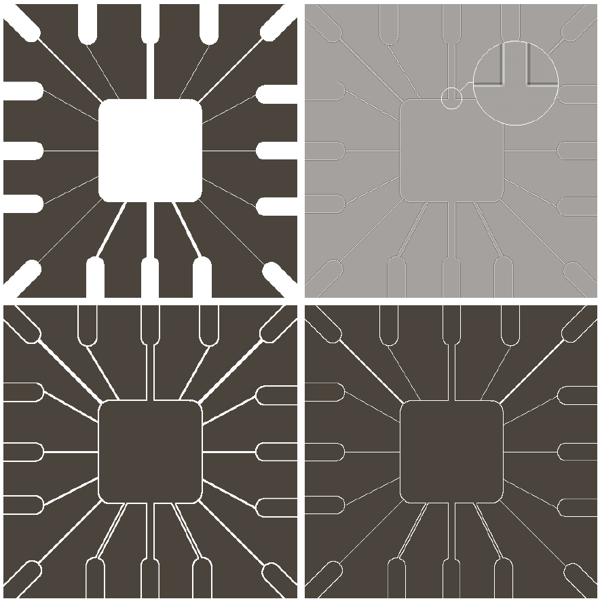
Line Detection

Slide 22
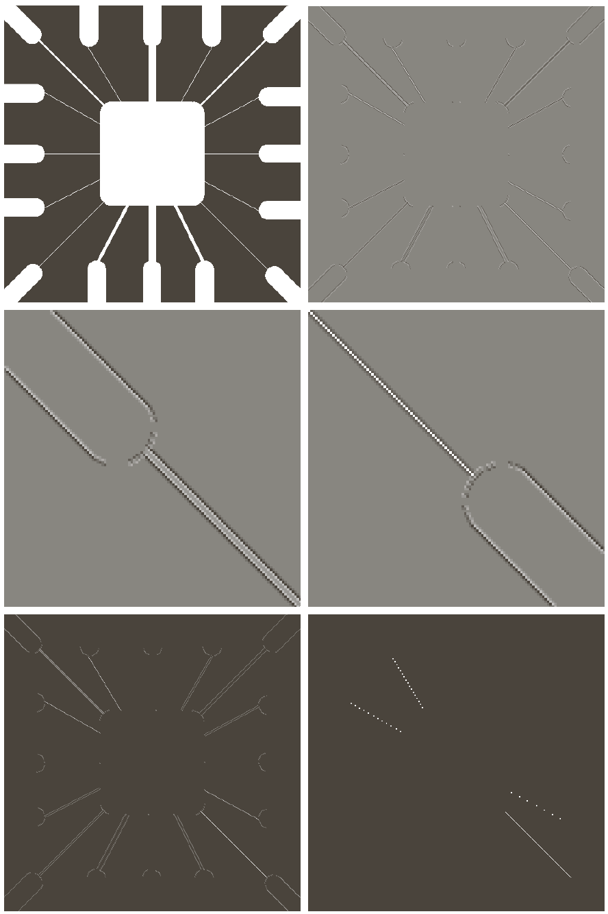

Slide 23
Edge Detection

Slide 25
Edge Detection

Slide 26
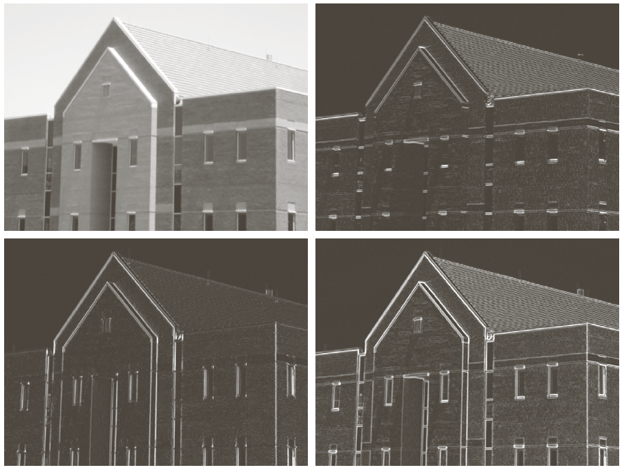

Slide 28
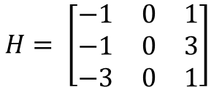
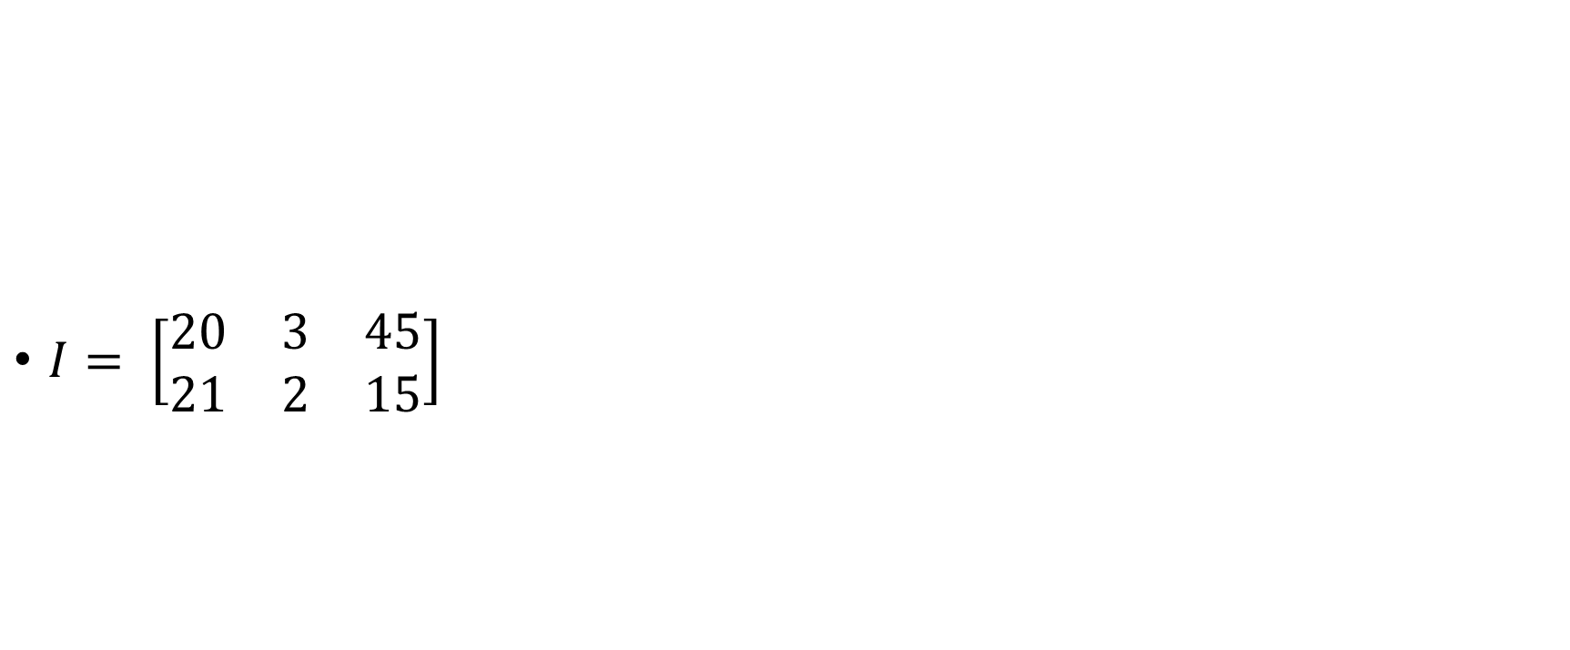
$I= \left[\begin{matrix}20 & 3 & 45 \\ 21 & 2 & 15\end{matrix}\right]$
$$H= \left[\begin{matrix}−1 & 0 & 1 \\ −1 & 0 & 3 \\ −3 & 0 & 1\end{matrix}\right]$$

